Slide 1
The Effect of Painkillers on Drug Misuse
fighting-r-ish:
Kristina White and Mahati Kalaparthy

Slide 2
Question of Interest
How does having used certain painkillers impact a respondent’s categorical DAST-10 score?

Slide 3
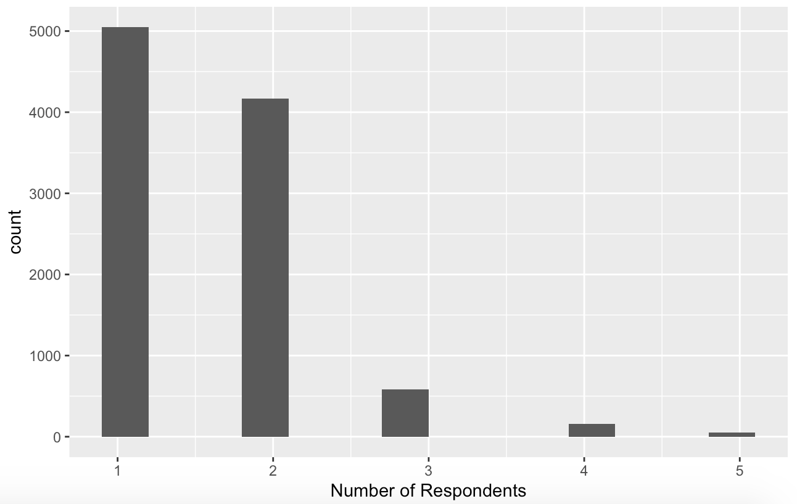
Number of Respondents in Each Category of DAST

Slide 4
Variables of Interest (Canada Dataset)
Response Variable: DAST_CAT
Explanatory Variables:
FENT_USE
BUP_USE
METH_USE
MORPH_USE
OXY_USE
OXYM_USE
TRAM_USE
TAP_USE
COD_USE
HYD_USE
HYDM_USE
SUF_USE

Slide 5
Proportional Odds Model
Full Model: DAST_CAT ~ FENT_USE+BUP_USE+METH_USE+MORPH_USE+OXY_USE+OXYM_USE+TRAM_USE+TAP_USE+COD_USE+HYD_USE+HYDM_USE+SUF_USE
Final Model: DAST_CAT ~ FENT_USE+BUP_USE+METH_USE+MORPH_USE+OXY_USE+OXYM_USE+TAP_USE+COD_USE+HYD_USE+HYDM_USE

Slide 6
Exponentiated Model Coefficients
FENT_USE: 1.382104
BUP_USE: 1.682875
METH_USE: 2.707081
MORPH_USE: 1.174278
OXY_USE: 1.231320
OXYM_USE: 1.671914
TAP_USE: 1.862583
COD_USE: 0.719550
HYD_USE: 1.166329
HYDM_USE: 1.188200

Slide 7
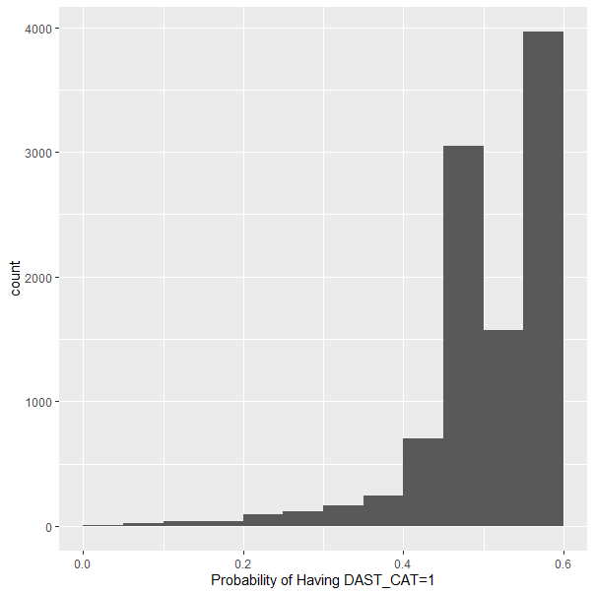
HISTOGRAM FOR PROBABILITY(DAST_CAT = 1)

Slide 8
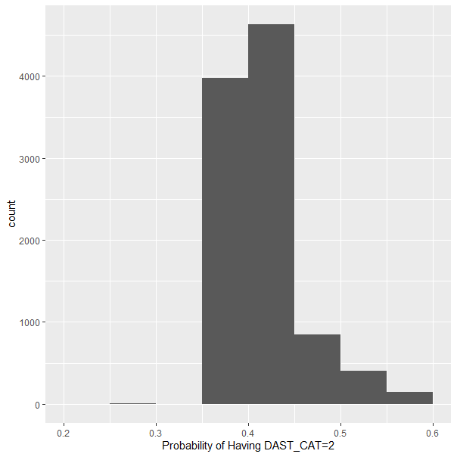
HISTOGRAM FOR PROBABILITY(DAST_CAT = 2)

Slide 9
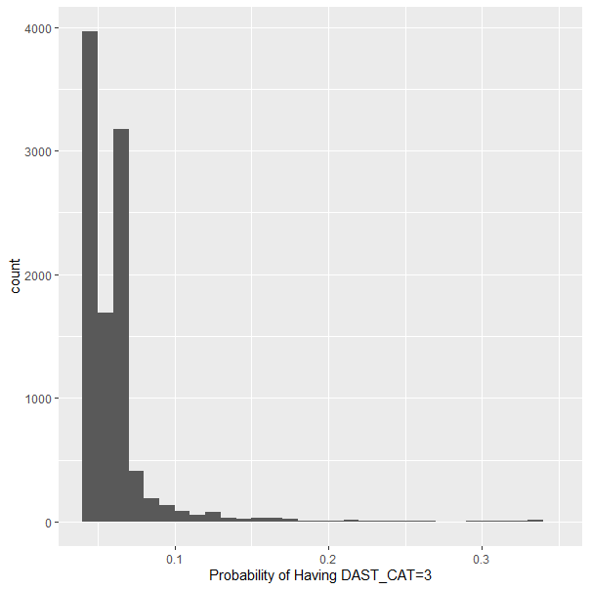
HISTOGRAM FOR PROBABILITY(DAST_CAT = 3)

Slide 10
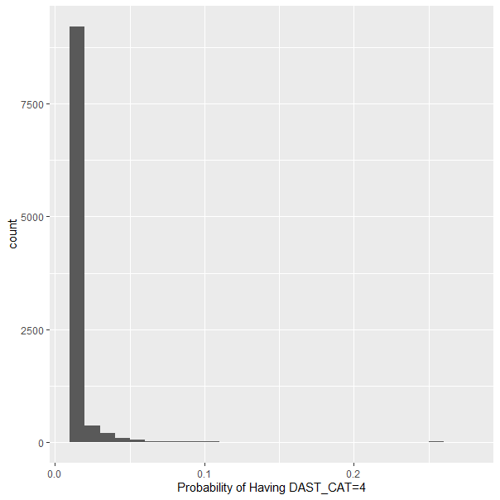
HISTOGRAM FOR PROBABILITY(DAST_CAT = 4)

Slide 11
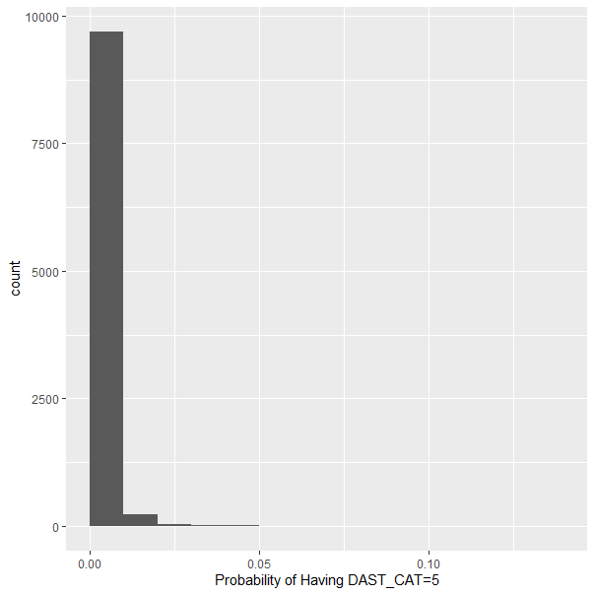
HISTOGRAM FOR PROBABILITY(DAST_CAT = 5)

